Slide 1
Business Report
HBFC Project

Slide 2
Answer 1
In Question 1 it was asked that what percentage of the total banks customers have availed personal loan .
So by inserting a pivot table I arranged the required data i.e total number of bank customer (count of id) in the values quadrant and similarly the personal loan in the columns quadrant .
By that we got the total number of bank customers divided into columns - Customers who have not availed Personal Loan and the Customers who have availed Personal loan .
9.60% of the banks customers have availed personal loan .

Slide 3
Answer 2
In this Question it was asked to generate a table with min, max, median and average for all numeric variables .
So by applying the formula I generated the tables with required Variables .
Formula used - =MIN(INDEX('Source Data'!$A$1:$O$5001,,MATCH('Answer 2'!B3,'Source Data'!$A$1:$O$1,0))) .

Slide 4
In this a basic formula of min , max , average and median was used with the index and match function as mentioned in the file .
OBSERVATION –
From the table we can clearly observe that as the there is a rise in the age of the customers there is a significant increase in there income as well . Also the family members is also rising with the age.
The minimum age of the banks customer is 23 and they are having the minimum income of 8 k/year as mentioned in the data and gradually as their age increases their income is increasing as well
And , this affects the other variables too such ccavg. now people who are having low income do not have any credit card spending and on the other hand people with high income ( in high age group ) are having more ccavg.

Slide 5
.
Now if we talk about mortgage only the customer who are in the maximum age group are having it . There is no mortgage at younger age but we can gradually see increase in mortgage with the increase in age .
As for the median , it is the almost same as the average while in some variables it differs a bit like in mortgage and a bit in ccavg.
Median is required when there are some outliers in the data .

Slide 6
Answer 3
In Question 3 it was asked to create a new categorical for the experience column and to create a chart for the new categorical
I created new categorical for experience as Experience Range
For creating Experience Range IF/Else Nested function was used . The formula used for it is =IF(B2<=10,"0-10 Years",IF(B2<=20,"11-20 Years",IF(B2<=30,"21-30 Years","30+ Years"))) .

Slide 7
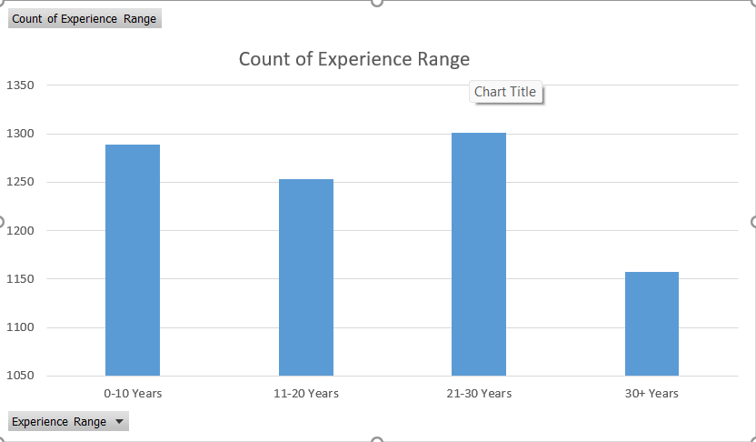
Here is the chart for Experience Range

Slide 8
Answer 4
In Question 4 it was asked to create a scatter plot for Age and the Experience variable and state your observation .
OBSERVATION
In the scatter plot we can clearly observe that both variables age and experience are positively correlated .
We can see that as there is a rise in the age of the customers there is also a rise in the Experience as well .

Slide 9
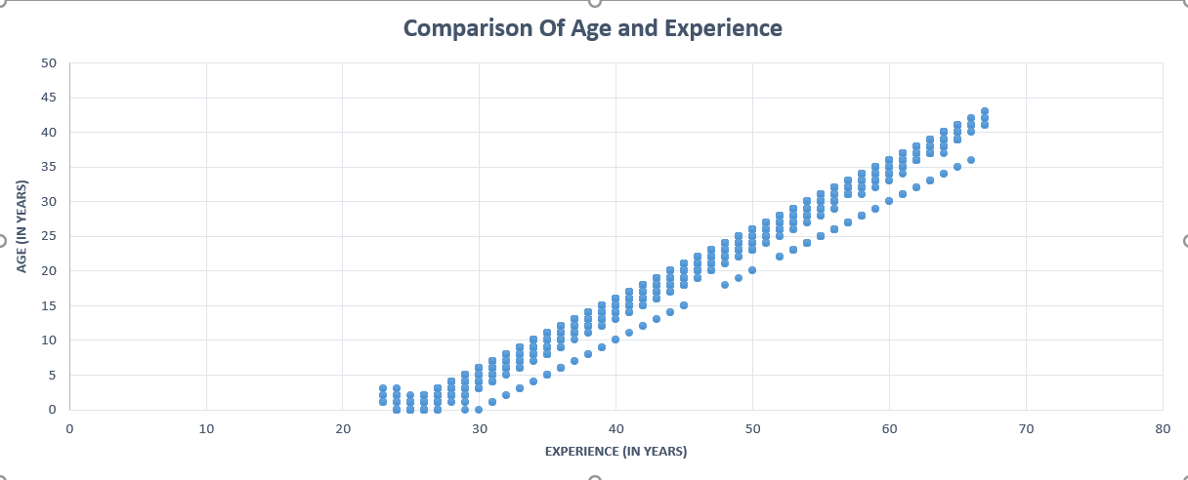
Here is the scatter plot

Slide 10
Answer 5
In Question 5 it was asked to identify the Top 3 Zip codes where the banks customer are located .
Top 3 Zip codes are –
94720 with 169 customers
94305 with 127 customers
95616 with 116 customers
Method used – Pivot Table

Slide 11
Answer 6
In Question 6 it was asked that what How many customers have a combination of Fixed Deposits and Credit Cards but not Personal loan
The number of those customer who have a combination of Fixed deposits and Credit cards but not Personal Loan is 147 .
Pivot Table was used to find this .

Slide 12
Answer 7
In Question 7 it was asked to calculate the Median Income of the customer who has not availed the Personal Loan and the Median Income of the customer who have availed the Personal Loan .
Median Income of Customers With Personal Loan (In K/ Year) :
142.5
Median Income of Customers With No Personal Loan (In K/Year) :
59 .

Slide 13
Observation -
From the data we can clearly see that the median income of customers who have availed the personal loan is much HIGHER than the customer who has not availed the personal loan .
There is a huge difference between the both variables .
This simply means that the customer who are having personal loan are also having higher income .

Slide 14
Answer 8
In this it was asked to create 4 different Pivot tables and summarize the values in percentage .
All 4 Pivot table created in the excel file .
With Highlighted values

Slide 15
Answer 9
In Question 9 it was asked to analyze the pivot table created in the previous question and state your observations and also state that which variable is important for our further study if we want analyze that which customer would want to buy the personal loan most likely and why .

Slide 16
Observations
In the comparison of Income Category VS Personal Loan we can clearly see that only the customers with the income range 100+(k/Year) have availed the personal loan the most (i.e 8.76%) as for the other income ranges 50-100 only 0.84% of the total customer in that range have availed personal loan and as for the range of 0-50 there are total of 38.28% customers but none of them has availed personal loan .
Also we can see in the comparison of education vs personal loan under the category of undergraduates only 1.86% of the total undergraduates (i.e 41.92%) have availed the personal laon.

Slide 17
Variables important for further study :
According to me the variables that are important for further study if we want to increase the personal loan holders are TD account or Fixed deposits because as we can see in the Pivot table the people not having TD account are 93.96% in total out of which 6.80% of people are having personal loan that is one of the highest number and thee are still many people left (87.16%) so we can do further study in this variable as we have more chances of people availing personal loan in this variable and as for people having TD account that is also a goo number as out of 6.04% (total) 2.80% of people are having personal loan so in future this number might increase .

Slide 18
.
Another variable would be the online variable of people having and not having the internet banking facilities or an online account with the bank .
So, as we can see in the comparison of Online VS Personal loan customer with online services – 5.82% of the total 53.86% have availed personal loan this is a good number and there are 53.86% customer left so in future this number might rise and as of the customers without he online services 3.78% of the total 40.32% customers have availed the personal loan and there are still 36.54% left so this is a good number as well we can study these variables more an generate more leads for personal loan .

Slide 19
Answer 10
In Question 10 it was asked to state a cost effective strategy for the bank . So my strategy would be –
First of all the bank already reached out to 5000 customers out of which 480 customers availed the loan so here we can narrow down the factors or the variables that affects the Personal Loan highly and then accordingly reach out to the specific targets that how we can build a cost effective strategy and without compromising the personal loan variable
So, as we saw from the previous questions –
From Answer 1 we observed that as the age of the customer is rising the experience is also rising due to that there is also a rise in the income of the customers hence more customer availed the Personal Loan .
Also, we also saw from the comparison of various variables from the pivot table in Answer 7 majority of the people buying the Personal Loan are the People from higher age group and people whose income is 100+(k/Year) .

Slide 20
.
3. So, we can clearly say that the most effective target would be the customers with higher income and higher age .
4. Also, there is one more variable that is Education Qualification when we compared education with personal loan in Answer 7 with the help of the pivot chart we observed that most of the professional customers were having personal loan.
So by all of these observations we reached to a conclusion that the most effective variables would be Higher Age customers , Customers having higher Income and Professional customers .
Aside all that we can also target the customers who are almost at the criteria of High Age because in future they might consider availing the Personal Loan .

Slide 21
All of these observations were from previous answers .
Thank you
By Yash Sundli

